Slide 1
Lending club case study
Minimize lending risk, maximize revenue
Indrajeet Jadhav
Suchin Chouta
4th October 2022

Slide 2
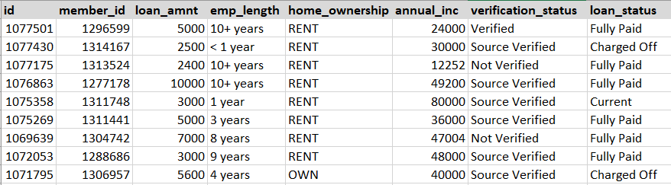
Dataset and Business objective
Past loan applicants from 2007 to 2011, their metadata, payment behavior and respective loan status ‘defaulted’ or not.
Understand the driving factors (or driver variables) behind loan default
Utilize insights from EDA for portfolio and risk assessment to give loans to safe customers and avoid risky applicants.
Dataset snapshot

Slide 3
High level approach
Data input
Data Cleaning
Univariate Analysis
Segmented univariate Analysis
Bivariate & Multivariate Analysis
Recommendations
Read dataset file
Read Metadata file
Row cleaning
Column cleaning
Missing values
Standardize values
Fix data types
Fix data quality issues
Derive important metrics e.g. “loan_to_income” ratio
Numerical feature analysis
Categorical feature analysis
Variables segmentation on ‘loan_status’
Analysis of numerical and categorical features
Analysis of multiple variables together.
Recommendations using analysis created.

Slide 4
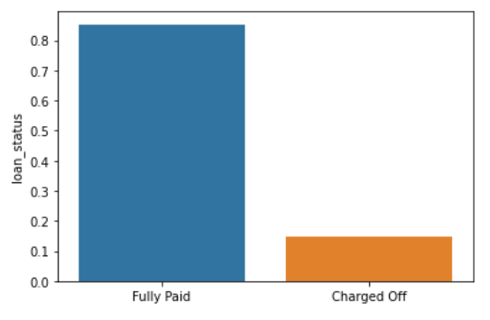
Results (1)
Benchmarking:
Observations and Conclusions:
14.7% people default in overall dataset.
This is a benchmark. Any segment of dataset with significant difference in distribution should be considered for further analysis and appropriate actions.

Slide 5
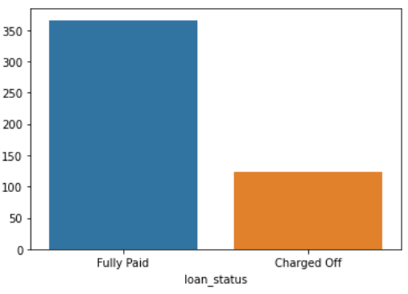
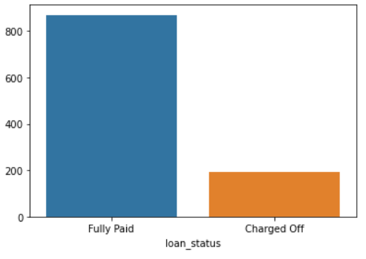
Results (2)
Applicants with credit revolving balance >40000
Applicants with credit utilization >98%
Observations and Conclusions:
People with credit revolving balance above 40k have higher default rate of 18.17%.
For credit utilization over 98%, more than 25% customers have defaulted.
These customers are risky to give loan as they have higher chance of loan default.

Slide 6
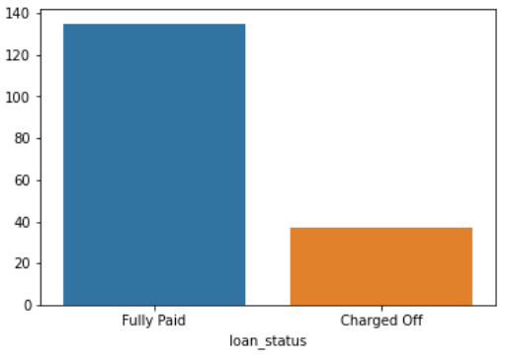
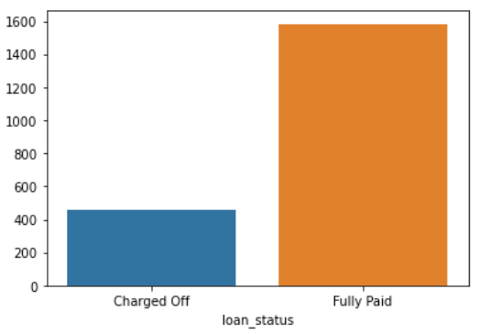
Results (3)
Applicants with credit lines>25
Applicants with public record
Observations and Conclusions:
People with credit lines above 25 seem to have high default rate of 21.5%.
People with public records seem to have high default rate of 22.5%.
These customers are risky to give loan as they have higher chance of loan default.

Slide 7
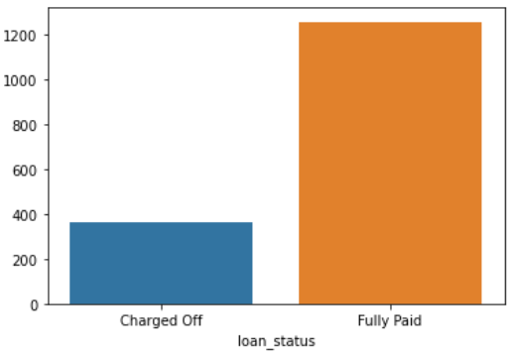
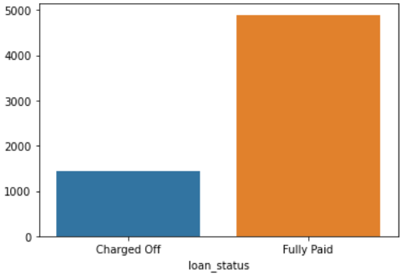
Results (4)
Applicants with record of bankruptcies
Applicants with loan to income ratio >30
Observations and Conclusions:
22.5% People with public record bankruptcies default out of 1258 people.
People with high loan_to_income ratio (>30) are risky with 22% default rate.
These customers are risky to give loan as they have higher chance of loan default.

Slide 8
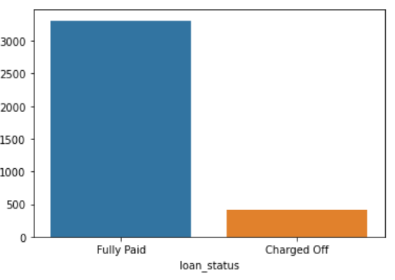
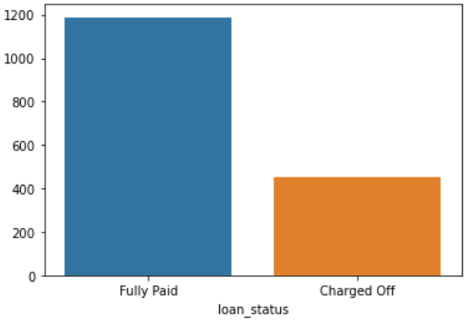
Results (5)
Applicants with loan to income ratio <6
Applicants with loan purpose as small business
Observations and Conclusions:
People with low loan_to_income ratio (<6) are safe people to give loan with 10% default rate.
Loans for small businesses, renewalble energy are of the highest risk with 27.7% people defaulting. People default very less for credit card, car and wedding. If these people have low loan to annual income ratio, These seem to be very safe loans. These customers are risky to give loan as they have higher chance of loan default.

Slide 9
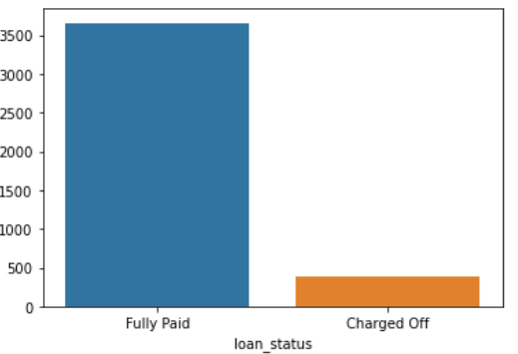
Results (6)
Applicants with loan purpose as credit card
Observations and Conclusions:
People default very less for credit card, car and wedding. If these people have low loan to annual income ratio, These seem to be very safe loans.
These customers are safe to give loan as they have higher chance of loan default.

Slide 10
Recommendations
Safer loans:
Below loan applicants profiles are less risky than most of loan applilcants and may be considered giving loans:
low loan_to_income ratio (<6)
Loan purpose : credit card, car and wedding
Risky loans:
Below loan applicants profiles are high risk than most of loan applicants and may be considered giving loans:
High credit revolving balance (above 40k)
Credit utilization over 98%
credit lines above 30
People with public records
high loan_to_income ratio (>30)
Loans for small businesses, renewable energy

Slide 11
Thank you Learner details:
Indrajeet Jadhav
Suchin Chouta
4th October 2022

